Slide 1


Metaverse
Lara Gomez
Pantysh Ghurburrun
Basmala Moumneh
Zhe Cao
Connie Lin
Jeremy Cheng

Slide 2

What is the metaverse?
Seen as a 3D digital space where multiple worlds come together to form one single network
Users can experience these worlds with a single character
Big companies envision a digital economy for users to interact with
Virtual reality and augmented reality can potentially be the key to fully immerse users within the metaverse
Notes:
Reference: https://www.wired.com/story/what-is-the-metaverse/

Slide 3
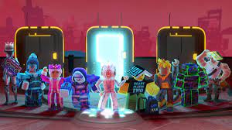
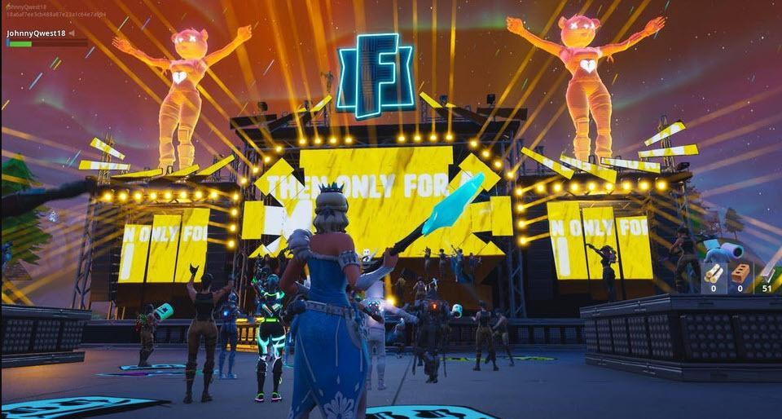
Current Examples of Metaverse
Roblox
Fortnite
Multiple worlds to visit with a single character
Virtual concerts
Notes:
What makes them less Metaverse than they could be is that it’s all focussed under one ecosystem and that they don’t really incorporate VR
Reference: https://www.adweek.com/creativity/inside-robloxs-vision-for-its-metaverse/
https://www.forbes.com/sites/paultassi/2022/01/21/fortnites-vision-of-the-metaverse-feels-like-it-has-stalled/?sh=52e9617b1df2

Slide 4
NFTs
NFTs (non-fungible tokens) act as unique, virtual tokens that say somebody owns an item
Virtual world requires virtual ownership
Not interchangeable, unlike currency
Stored in “wallets” on the blockchain, which is a public, shared, and distributed database of transactions
Decentralized rather than centralized databases used in most servers

Slide 5
NFTs and Metaverse
NFTs can be exchanged in virtual marketplaces, so instead of buying on a website, someone could buy in a 3D metaverse world to make more immersive
Can create virtual art galleries of NFTs to be explored in the metaverse
Could be used to store virtual properties, like owning land in a metaverse
An NFT in a wallet could be used to give someone access to a space, like a virtual ticket for the metaverse

Slide 6
NFTs Misconceptions and Challenges
However:
Similar to buying a physical painting, having an NFT does not necessitate copyright or moral rights unless negotiated otherwise
Can’t undo fraudulent transactions
Since NFTs can be exchanged for real money, integrations may result in things feeling more like “work” or attract users who are only in it for the money

Slide 7

Opportunities
Business Opportunities
Simulations/Experiments
01
02
Potential to change all industries
Virtual real estate
Gaming
Shopping experience
Marketing and advertising
Immersive simulations
Difficult-to-implement phenomena
Mitigates risks to users
Notes:
Business opportunities
Can help businesses connect with their clients on a new personal level and reach new markets. Can engage customers in exclusive brand experiences in a VR world. Enhanced shopping experience will change the way we shop and interact with brands.
perform simulation experiments on difficult-to-implement phenomena
In some cases, learning in real-world environments, such as those involving chemical experiments, can be risky. The use of special equipment (such as virtual reality headsets and glasses) can create immersive simulations of real environments. These technologies can create scenarios that would be impossible or impractical in the real world.
Making Diverse Educational Resources Accessible
Universities are facing budget constraints and are unable to access the resources they need to learn due to high costs and maintenance difficulties. Metaverse can provide an affordable alternative to help them overcome these constraints.
Metaverse can close the education gap between rural and urban by giving remote students access to educational resources.
Metaverse offers opportunities to teach and have fun. Immersion in games can increase engagement in learning activities.
Attracting a young crowd
Children and young people are the main groups in the metaverse of gaming. Compared with older generations, this demographic is more experience-driven and sees interesting and exciting learning opportunities in the metaverse.

Slide 8
Opportunities
Educational Resource
User Interactions
03
04
Remote education
Provide opportunities for learning by doing
Accessible to everyone
Socialization/interactions not limited by disability, physical location, language barriers etc.
Notes:
Business opportunities
Can help businesses connect with their clients on a new personal level and reach new markets. Can engage customers in exclusive brand experiences in a VR world. Enhanced shopping experience will change the way we shop and interact with brands.
perform simulation experiments on difficult-to-implement phenomena
In some cases, learning in real-world environments, such as those involving chemical experiments, can be risky. The use of special equipment (such as virtual reality headsets and glasses) can create immersive simulations of real environments. These technologies can create scenarios that would be impossible or impractical in the real world.
Making Diverse Educational Resources Accessible
Universities are facing budget constraints and are unable to access the resources they need to learn due to high costs and maintenance difficulties. Metaverse can provide an affordable alternative to help them overcome these constraints.
Metaverse can close the education gap between rural and urban by giving remote students access to educational resources.
Metaverse offers opportunities to teach and have fun. Immersion in games can increase engagement in learning activities.
Attracting a young crowd
Children and young people are the main groups in the metaverse of gaming. Compared with older generations, this demographic is more experience-driven and sees interesting and exciting learning opportunities in the metaverse.

Slide 9
Challenges
Safety
Privacy
01
02
Technical difficulties
03
Addiction/Escapism
Mental disorders
Physical health
Cyber attacks
Unlawful collection of data
Cost of technology
Inadequate infrastructure
Notes:
Addiction as metaverse will be another form of social media
The addiction can have both physical and psychological effects on the users. The physical effects can range from obesity or cardiovascular diseases. The psychological effects can lead to depression or anxiety.
Consumers are concerned about safety
The metaverse will need to transmit large amounts of data, much of which is privacy-related. The risk of cyber attacks will increase and can have serious consequences. Institutions will be needed to take responsibility for protecting the metaverse and maintaining consumer trust.
Technical difficulties in building metaverse
To build the metaverse requires a large amount of resources that are real and limited. Examples include rare metals for electronic devices, energy for data center power, etc. As the number of users increases, these resources may be depleted. To support the transfer of large amounts of data between the virtual and physical worlds, an efficient communication infrastructure is required to optimize transmission speed, reliability and latency.

Slide 10
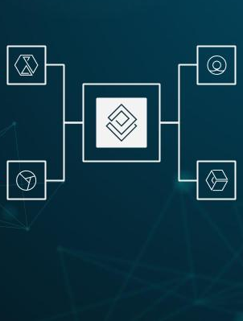
Current Role of HCI
Immersive Gaming
AR
VR
Main Interaction Method:
Digital Screen
Provide Feedback
Display Information
Control Device Options
Limited Immersive Experience
Side-effects of being immersed when using Head
Mounted Displays(HMDs)

Slide 11
Future Role of HCI
Full Immersive Experience
Extended Reality (XR) = VR (Virtual Reality) + AR (Augmented Reality) + MR (Mixed Reality)
Main Interaction Method:
Head Mounted Displays
Environment Analysis
Detect hidden heat/See through walls/Detect Water
Hand Controls
Sensors for the User to Adapt to User Needs
Stress Level
Electrical Activity (EMG)
Life in the Metaverse = Real Life
Used For Day To Day Tasks
Online Personas = Real Life Personas
Comfortable User Experience

Slide 12
Future Role of HCI
HCI designer Focus:
Simplicity + Intuitive design
Dynamic and personalized experiences will needed for all users of the Metaverse to be comfortable
Prevent information overload as the user could easily feel overwhelmed due to the extensive stimuli
Content engagement must be meaningful blurring the line between real-world navigation
Visual distractions must be kept to a minimum
Building Societies not Platforms
Knowledge of economics, anthropology, urban societies and many more
Living an Experience Vs Giving an Experience
Immersed enough to reach a goal

Slide 13
Bibliography
Editor, F. (2022, October 06). Importance of Intuitive Interface and Its Uses in the Metaverse. Retrieved from https://futurside.com/importance-of-intuitive-interface-and-its-uses-in-the-metaverse/
Feldman, B. (2022, October 17). How Video Gamers Beat NFTs. Retrieved from https://webcache.googleusercontent.com/search?q=cache:6hHvGBj2QzMJ:https://www.bloomberg.com/news/features/2022-10-17/how-gamers-beat-nfts&cd=1&hl=en&ct=clnk&gl=ca&client=safari
Fonarov, O. (2022, October 12). Council Post: What Is The Role Of NFTs In The Metaverse? Retrieved from https://www.forbes.com/sites/forbestechcouncil/2022/03/11/what-is-the-role-of-nfts-in-the-metaverse/?sh=c6ae4a6bb87dhttps://www.plainconcepts.com/nft-blockchain-metaverse/
Gamespad. (2022, September 22). Emerging Business Opportunities in the Metaverse: Report 2022 by GamesPad. Retrieved from https://www.globenewswire.com/en/news-release/2022/09/22/2520915/0/en/Emerging-Business-Opportunities-in-the-Metaverse-Report-2022-by-GamesPad.html
Inc., S. (n.d.). Request Box. Retrieved from https://skeb.jp/works?sort=date&genre=art

Slide 14
Bibliography
Jaloza, L. B. (2022, May 17). Inside Facebook Reality Labs: The next era of human-computer interaction. Retrieved from https://tech.fb.com/ar-vr/2021/03/inside-facebook-reality-labs-the-next-era-of-human-computer-interaction/
The Metaverse Will Give Designers the Chance to Create a Better World. (n.d.). Retrieved from https://builtin.com/design-ux/virtual-world-design-ethics
Nir Kshetri Professor of Management. (2022, September 13). Six benefits that the metaverse offers to colleges and universities. Retrieved from https://theconversation.com/six-benefits-that-the-metaverse-offers-to-colleges-and-universities-188950
Rasha. (2021, September 02). NFTs and Canadian Copyright Law. Retrieved from https://mcmillan.ca/insights/nfts-and-canadian-copyright-law/

Slide 15
Bibliography
Ravenscraft, E. (2022, April 25). What Is the Metaverse, Exactly? Retrieved from https://www.wired.com/story/what-is-the-metaverse/
Research trends: What's next for human-computer interaction in the metaverse and beyond. (n.d.). Retrieved from https://research.adobe.com/news/research-trends-whats-next-for-human-computer-interaction-in-the-metaverse-and-beyond/
Rodríguez, E. M. (2022, August 31). How important are NFTs and Blockchain in the Metaverse? Retrieved from https://www.plainconcepts.com/nft-blockchain-metaverse/
Support Mochi Buddies on Ko-fi.com! ❤️. (n.d.). Retrieved from https://ko-fi.com/mochibuddies
Tan, Z. (2022, July 11). Metaverse, HCI, and Its Future. Retrieved from https://www.atlantis-press.com/proceedings/mhehd-22/125975885
Tassi, P. (2022, January 24). Fortnite's Vision Of The Metaverse Feels Like It Has Stalled. Retrieved from https://www.forbes.com/sites/paultassi/2022/01/21/fortnites-vision-of-the-metaverse-feels-like-it-has-stalled/?sh=52e9617b1df2

Slide 16
Bibliography
Trias. (2022, June 07). Metaverse: An Open and Destined Future. Retrieved from https://medium.com/coinmonks/metaverse-an-open-and-destined-future-b652734fbdf2
What Are NFTs? A Beginner's Guide by Meta. (2022, September 29). Retrieved from https://about.fb.com/news/2022/06/what-are-nfts-beginners-guide-by-meta/
Wootton, C. (2021, April 20). Inside Roblox's Vision for Its Metaverse. Retrieved from https://www.adweek.com/creativity/inside-robloxs-vision-for-its-metaverse/

